Slide 1
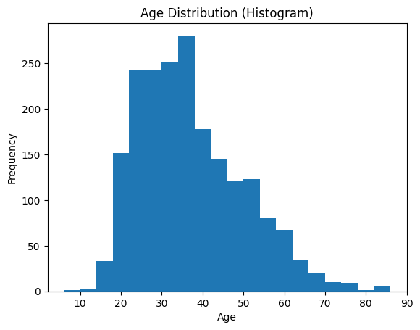
Most individuals fall within the 20–40 age range
Very few individuals are below 18 years or above 60 years
The distribution shows that incidents are more common among young adults and middle-aged individuals

Slide 2
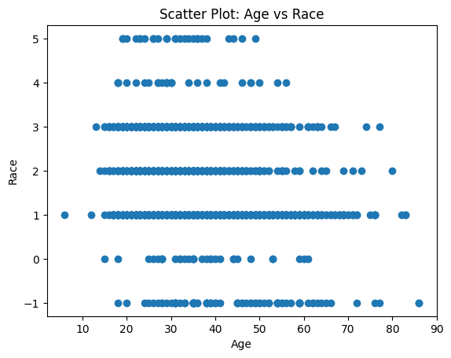
Certain racial groups appear more frequently in specific age ranges
Some racial categories show higher representation in younger age groups, while others are distributed across a wider age range
The variation indicates demographic differences among groups represented in the dataset

Slide 3
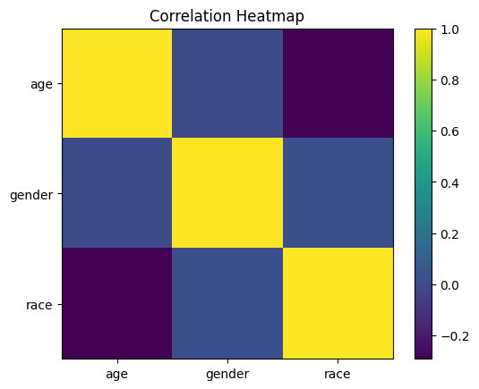
Identify strong relationships between variables
Detect redundant features
Understand which variables might influence clustering

